Slide 1


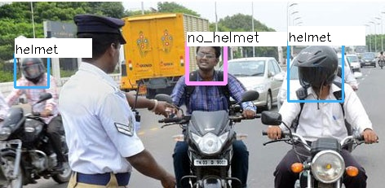

GRAYMATICS – Video Analytics for HELMET detection
Detect vehicle drivers driving with or without a HELMET
Project Description & Benefits
Our Capstone project is to build an AI solution which can annotate images of riders without a HELMET in a video stream from traffic cameras on the roads.
This solution, together with other algorithms addresses the need to ensure safety of two-wheeler riders on the roads.
You only look once (YOLO), real-time object detection system.
Solution
YOLOv3: Real-Time Object Detection used given its strengths of speed and accuracy.
Model trained for 2 classes – Helmet & No Helmet
53 convolutional layers & Darknet-53.
Bulk Image Downloader tool for data & LabelImg for annotations.
Train model in a Docker container
Finally the results – run the detection on a video stream. Sample output shown beside.
Driver without a HELMET is detected amongst others
Industry Partner
Graymatics is a cognitive media processing company based in Santa Clara, California, United States and in Singapore. The company is most well known for its digital video analysis and image-recognition technology, a platform capable of identifying the brands of products within images or video content.
Team Members
David Tan Leng Poh
Vivek Bhatnagar
Notes:
The fonts are embedded in the PPT slide
You can change the font sizes to get a desirable fit
The smallest font size used should be 26 for main content, 22 for captions
To change the photo, right click > Change Picture…
When adding more photos, duplicate the current photo to achieve a consistent style

